Slide 1
IET 333: Week 2
Jung-woo Sohn (jzs177@psu.edu)
College of Information Sciences and Technology
The Pennsylvania State University

Slide 2
More from last week:
Exponential growth: hard to predict
Bill Gates myth?
“640Kb ought to be enough for anybody.” (1981)
Design mistake with software:
8-bit CPU: Intel 8080
Maximum memory: 64Kb
16-bit CPU: Intel 8086
640Kb (1Mb)
32-bit CPU (Intel x86 series, 80386):
4Gb
64-bit CPU (AMD x64)

Slide 3
Opportunity cost: decision making
“the value of the best alternative forgone”
Examples:
A gardener: plant potato or carrots (others)?
Career choice: college education or working?
- tuition * 4 + higher_annual_income * years
lower_annual_income * (years + 4)
Investment?
Any suggestion to dominance of compound interest?
Substitution
You cannot have both at the same time!
Resource allocation under substitution

Slide 4
Opportunity cost
Compound interest:
Investment opportunity
5% of annual interest (simple interest)
Invest on a restaurant business…
With annual 5% profit growth
Which will you choose?
Incentive for the bank:
Need to switch to compound interest
In order to compete against ``business’’ investment opportunities.

Slide 5
Cashflow table
Benefit/cost analysis
Revenue/expenditure, cash inflow/outflow
Tabulation of cash flow: Cashflow table
Example:
You borrow $2000 today and pay back the loan over three years
Annual payment of $800
Year | Cashflow
0 | $2000
1 | -800
2 | -800
3 | -800

Slide 6
Cashflow table:
Whose cashflow table?
Note the signs!
Cashflow table for the bank:
Year | Cashflow
0 | -$2000
1 | 800
2 | 800
3 | 800

Slide 7
Cashflow table and interest rate:
Example: Develop a cashflow table for Jack
Jack borrows $5000 at 8% annual rate. At the end of every year, he plans to pay $1000 and the interest for the year. At the end of the fourth year, he plans to pay back the remainder of the loan with the interest.
What do we need?
Year | Cashflow
0 | $5000
1
2
3
4

Slide 8
Auxiliary table for cashflow table buildup
Example:
Jack borrows $5000 at 8% annual rate. At the end of every year, he plans to pay $1000 and the interest for the year. At the end of the fourth year, he plans to pay back the remainder of the loan with the interest.
Year | Principal | Interest | Total
1 | $1000 | $400 | $1400
2
3
4
Notes:
1400
1320
1240
2160

Slide 9
Cashflow table buildup
Auxiliary table:
Jack’s payment
Year | Principal | Interest (8%) | Total
1 | $1000 | $400 | $1400
2 | 1000 | 320 | 1320
3 | 1000 | 240 | 1240
4 | 2000 | 160 | 2160
Cashflow table:
Year | Cashflow
0 | $5000
1 | 1400
2 | 1320
3 | 1240
4 | 2160

Slide 10

Analytic approach:
Definitions
Principal: $P$
Future or Final sum: $F$
Interest rate: $r$ (or $i$)
Total time periods: $n$
Exercise: equation?
$F= ?$

Slide 11
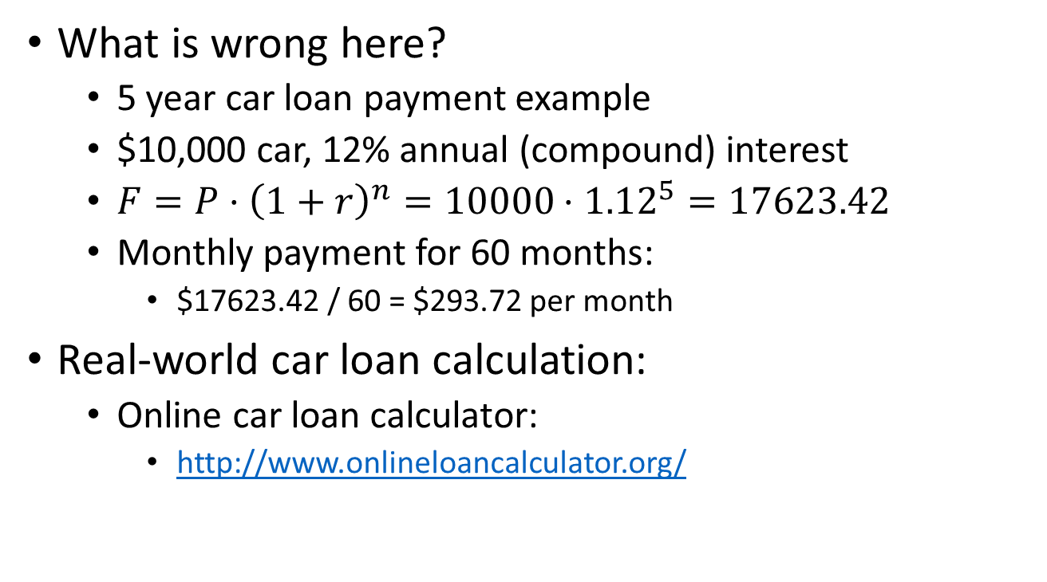
Amortization: periodic payment
What is wrong here?
5 year car loan payment example
$10,000 car, 12% annual (compound) interest
$F=P⋅{\left(1+r\right)}^{n}=10000⋅{1.12}^{5}=17623.42$
Monthly payment for 60 months:
$17623.42 / 60 = $293.72 per month
Real-world car loan calculation:
Online car loan calculator:
http://www.onlineloancalculator.org/
Notes:
$222.44

Slide 12
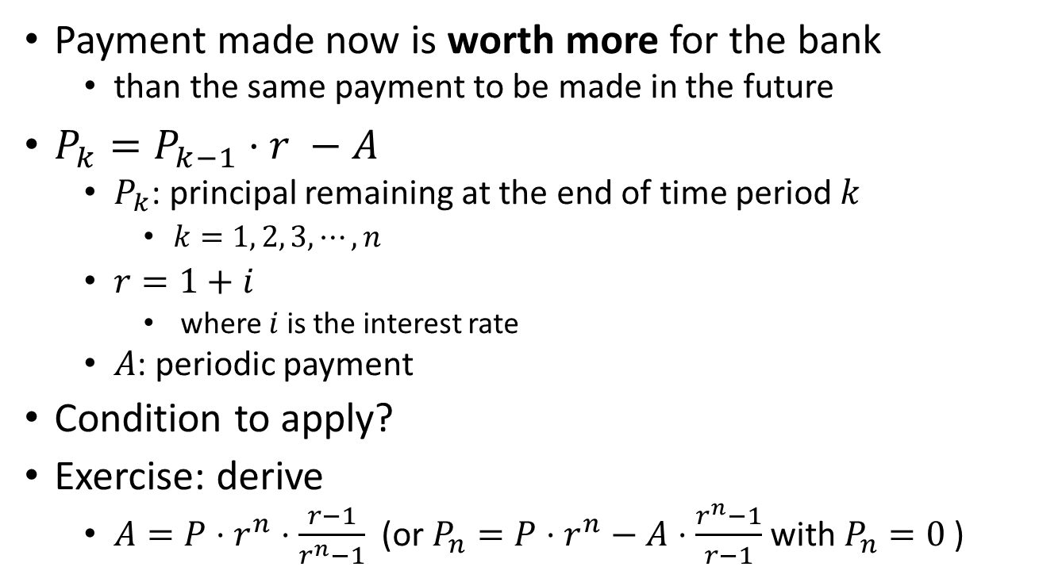
Amortization: periodic payment
Payment made now is worth more for the bank
than the same payment to be made in the future
$P_{k}=P_{k−1}⋅r −A$
$P_{k}$: principal remaining at the end of time period $k$
$k=1, 2, 3,⋯, n$
$r=1+i$
where $i$ is the interest rate
$A$: periodic payment
Condition to apply?
Exercise: derive
$A=P⋅r^{n}⋅\frac{r−1}{r^{n}−1}$ (or $P_{n}=P⋅r^{n}−A⋅\frac{r^{n}−1}{r−1}$ with $P_{n}=0$ )

Slide 13
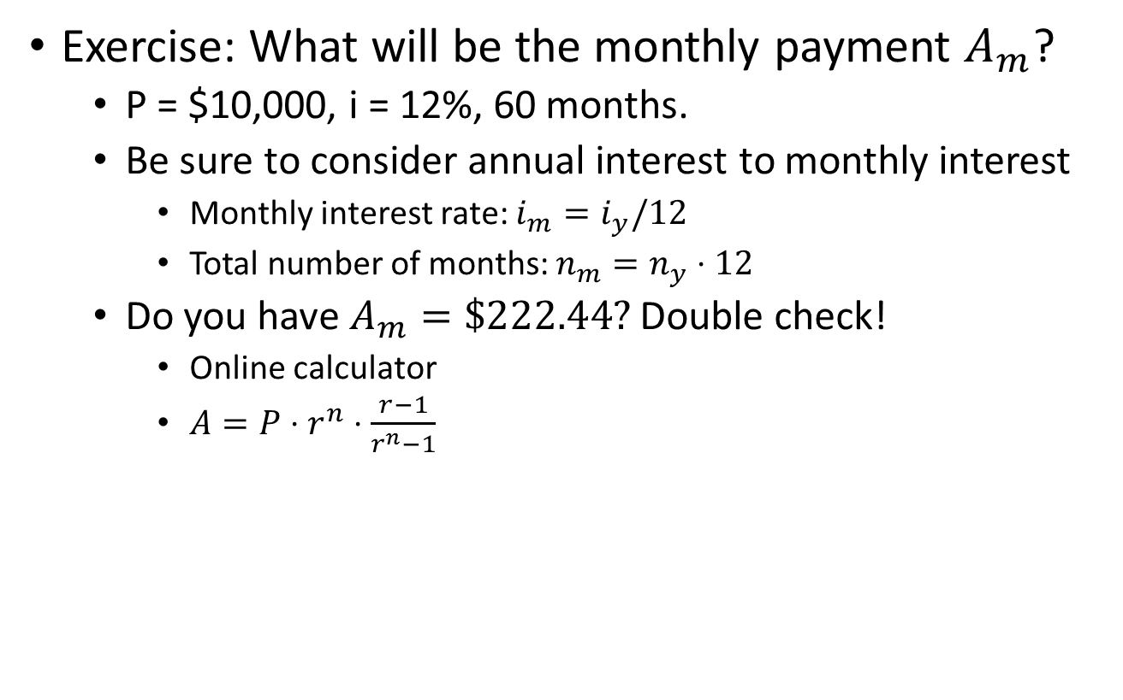
Amortization: periodic payment
Exercise: What will be the monthly payment $A_{m}$?
P = $10,000, i = 12%, 60 months.
Be sure to consider annual interest to monthly interest
Monthly interest rate: $i_{m}=i_{y}/12$
Total number of months: $n_{m}=n_{y}⋅12$
Do you have $A_{m}=\$222.44?$ Double check!
Online calculator
$A=P⋅r^{n}⋅\frac{r−1}{r^{n}−1}$

Slide 14
Periodic payment vs. one-time payment
Fill in the blanks:
Principal: $10,000
Annual interest: 12%
Loan period: 5 years
 | One-time payment | Periodic payment
Principal | $10,000 | $10,000
Future | $17,623.41 | $17,623.41
Total payment | $17,623.41 | $222.44 * 60 = $13,346.66
Notes:
F = 17623.41 vs. 13346.66

Slide 15
They are the same:
Under 12% annual interest rate:
$10,000 now
Single payment of $17,623.41 after 5 years
Monthly payment of $222.44 for 5 years
$13,346.66

Slide 16
Cash flow diagram:
Upward: benefit
Downward: cost
$350
$180
$200
$120
$90
0
1
2
3
4
5
$400

Slide 17
Exercise:
Monica plans to save $300 every month for her start-up capital. Her local bank provides a savings plan with 6% annual interest rate and she decided to put her money in the savings account. What will be the total in the savings account after 4 years later?

Slide 18
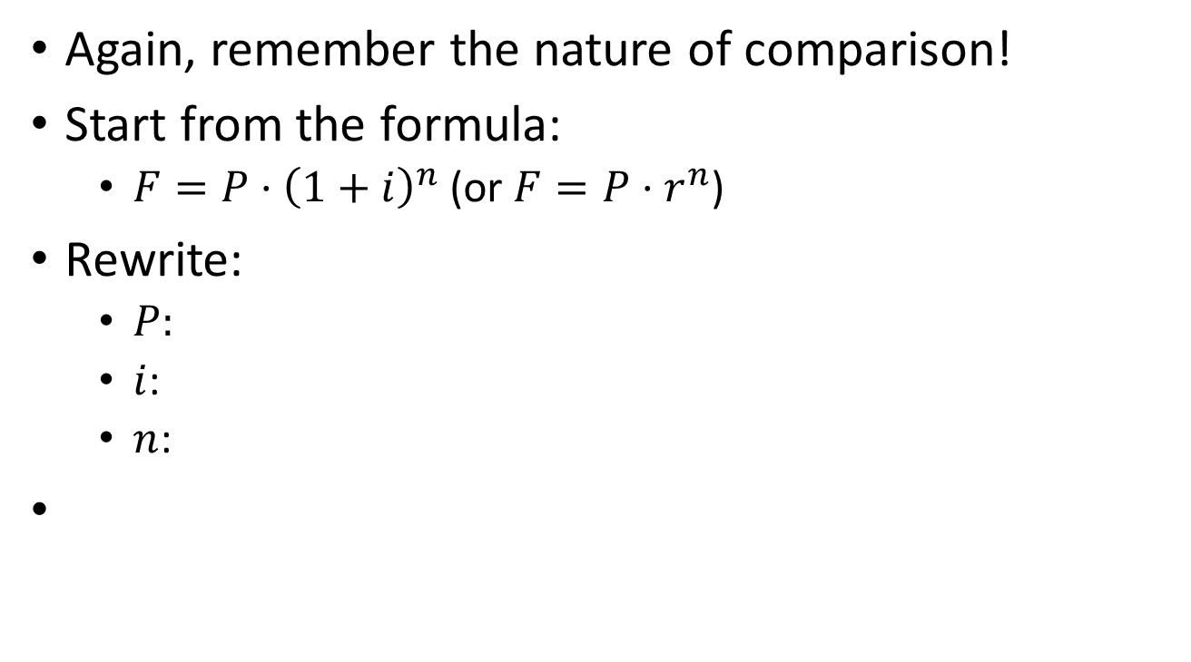
Compound interest formula: different cases
Again, remember the nature of comparison!
Start from the formula:
$F=P⋅{\left(1+i\right)}^{n}$ (or $F=P⋅r^{n}$)
Rewrite:
$P:$
$i$:
$n$:

Slide 19
Exercise:
Jenny deposits $300 now in her account and leaves it there for 8 years to earn interest rate of 6% per year. (compound) How much will she get at the end of 8th year?

Slide 20
Exercise:
John will need $5000 in 4 years as down payment for an apartment he plans to buy. How much should he save now in a CD that pays 7% yearly interest? (compound)

Slide 21
Exercise:
Joe gets back $4000 for a one-time deposit of $3,200 made six years ago in a money market account. What annual interest rate did he earn? (compound)

Slide 22
Exercise:
Jaya plans to surprise her son with a cash gift of $1000. She can afford to save $500 now in a bank account that will earn an annual interest of 6%. How long will it take for the $500 deposit grow up to be $1000?

